Slide 1
Introduction
Twitter has now become a useful way to build one's business as it helps in giving the brand a voice and a personality. The platform is also a quick, easy and inexpensive way to gain valuable insight from the desired audience. Identifying the sentiments about the product/brand can help the business take better actions.

Slide 2
Dataset Description
This dataset contains around 7k tweet text with the sentiment label.
The file train.csv has 3 columns
tweet_id - Unique id for tweets. tweet - Tweet about the brand/product sentiment - 0: Negative, 1: Neutral, 2: Positive, 3: Can't Tell

Slide 3
What and Why Sentiment Analysis
Sentiment analysis (also known as opinion mining) refers to the use of natural language processing, text analysis and computational linguistics to identify and extract subjective information in source materials. Consumers can use sentiment analysis to research products and services before a purchase. Production companies can use the public opinion to determine acceptance of their products and the public demand. Movie-goers can decide whether to watch a movie or not after going through other people’s reviews.

Slide 4
Pre-Work
Usernames are mentioned more often than not. Usually they consist of some alphabets and numbers, and do not contribute much towards sentiment classification, except for increasing the size of the feature vector.
URLS too are not required in our task.
Repeated letters People often repeat letters in some words, in order to stress upon a particular emotion. For example:- sad, saaaad, saaaddd. All of them mean the same, yet it is not possible to distinguish between them if guided only by their spellings. Hashtags Words in hashtags may be read different from the same word without the hash tag
Punctuations and additional spaces.

Slide 5
Challenges
All tweets were converted to lower case
All links and urls were replaced by generic word URL
All usernames were replaced by generic word USER
Words with hashtags were replaced with the same words without the hashtag
Punctuations and additional white spaces were removed from the tweets.
All the above work was done in python

Slide 6
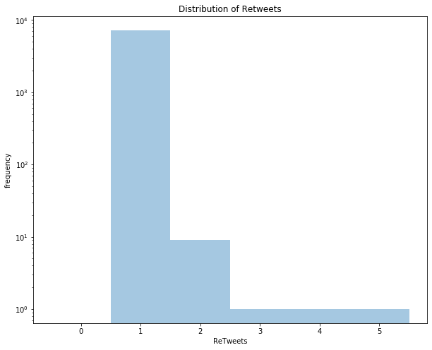
Graph Showing the Importance
Graph 1

Slide 7
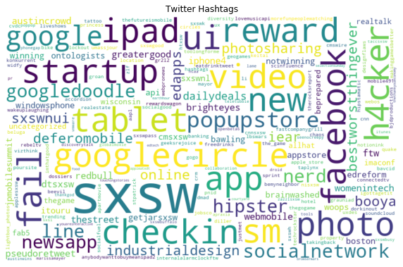

Slide 8
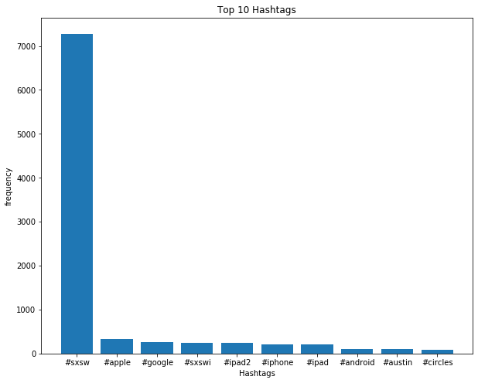

Slide 9
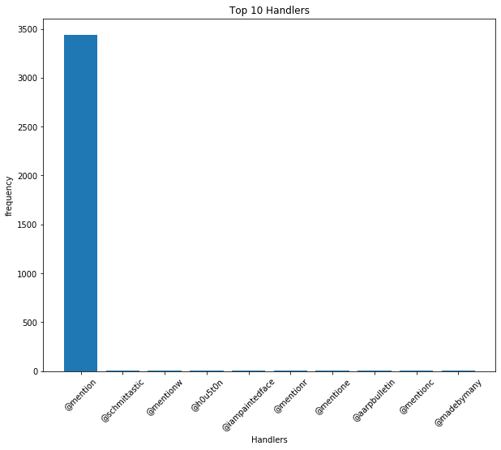

Slide 10
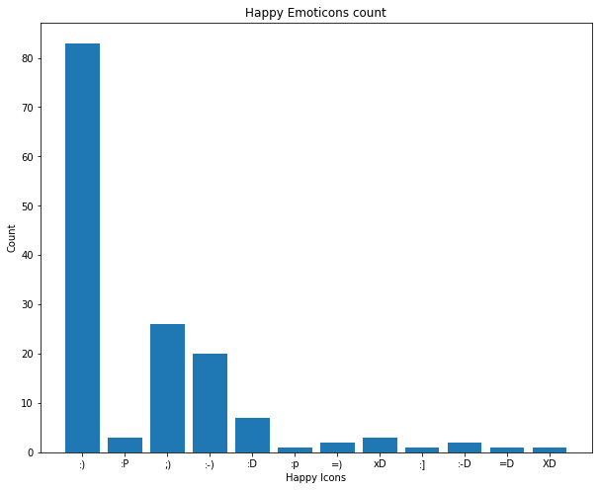
Total number of Happy Tweets= 150
Happy Ratio : 0.8670520231213873

Slide 11
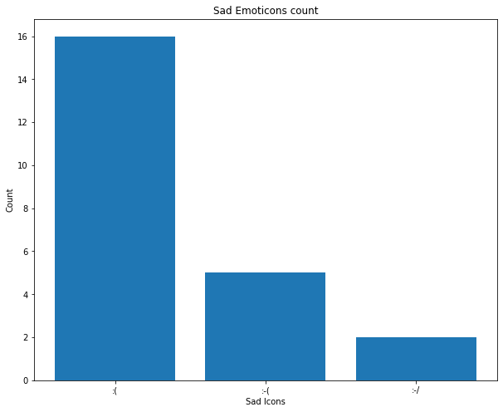
Total number of Sad Tweets= 23
Sad Ratio : 0.1329479768786127

Slide 12
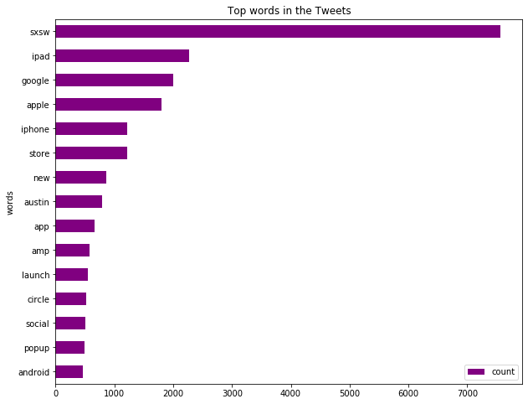

Slide 13
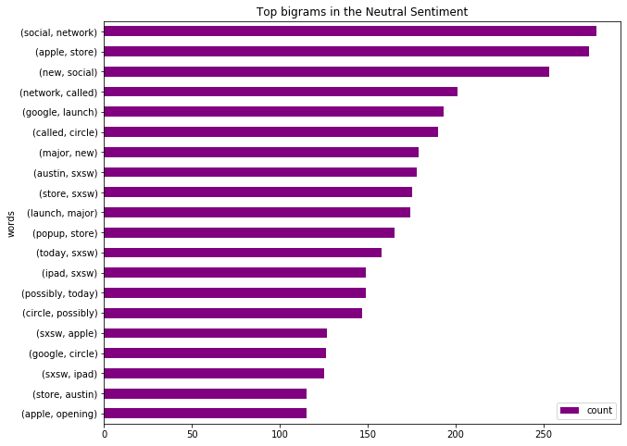

Slide 14
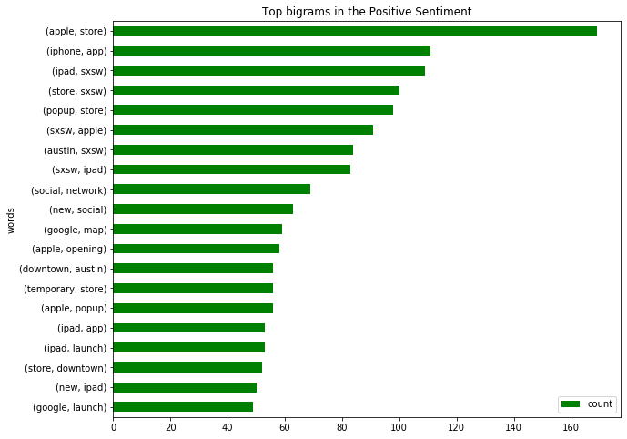

Slide 15
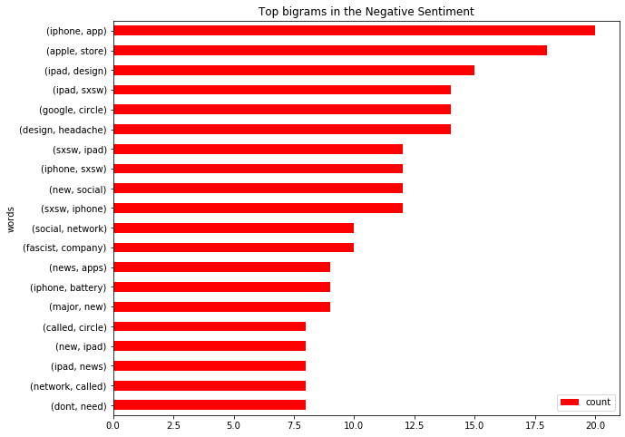

Slide 16
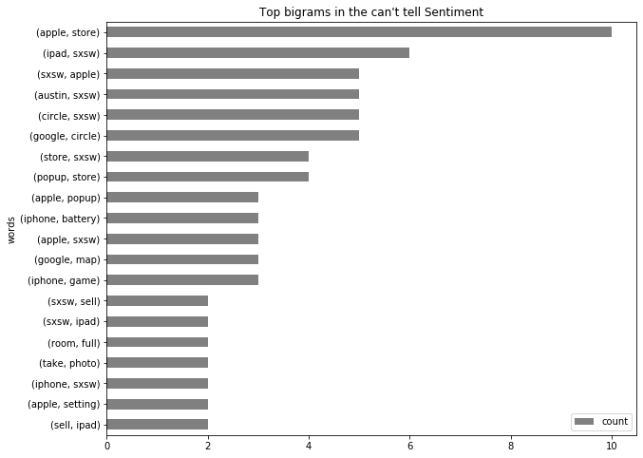

Slide 17
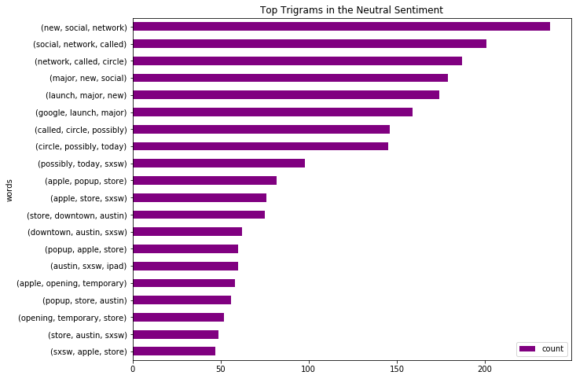

Slide 18
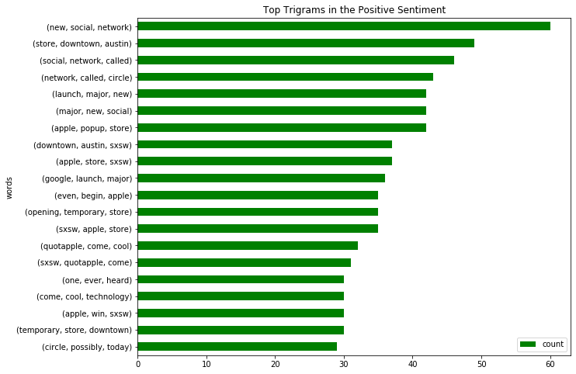

Slide 19
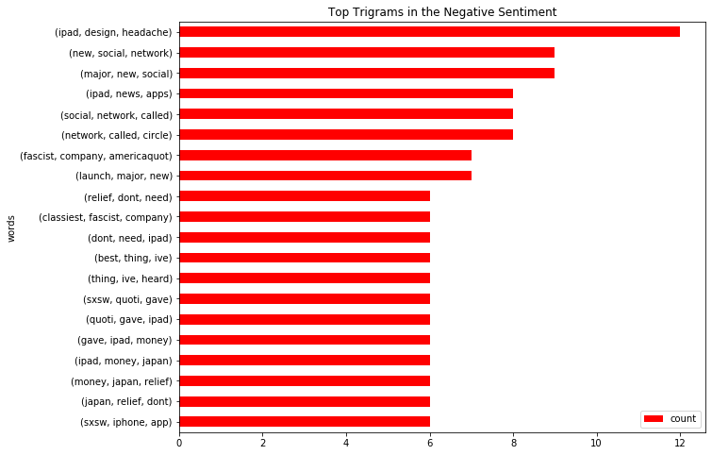

Slide 20
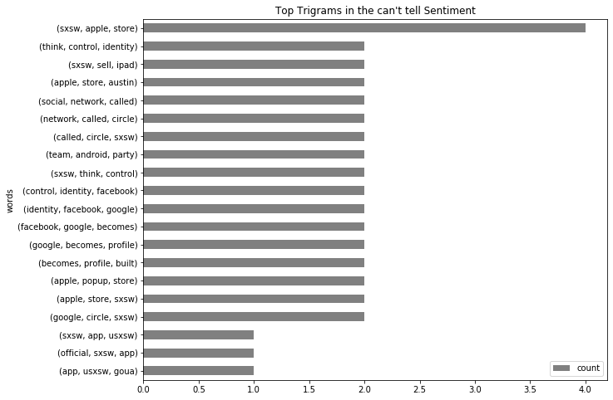

Slide 21
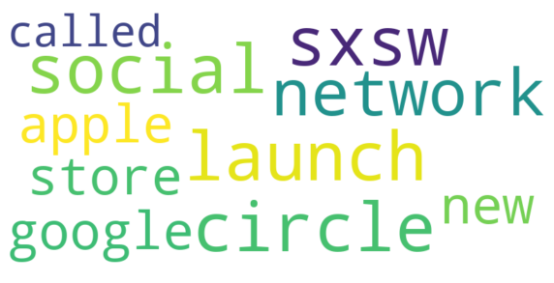

Slide 22
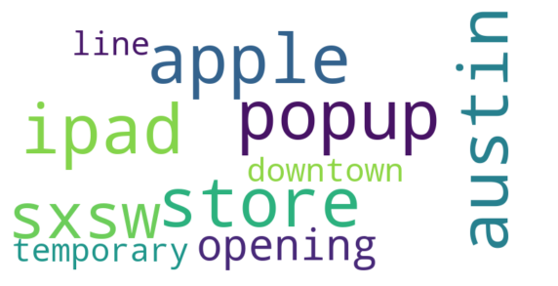

Slide 23
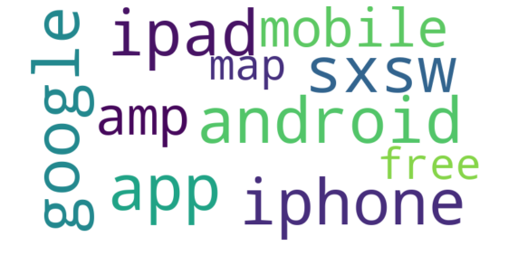

Slide 24
Model Name: MultinomialNB
Classification Report:
precision recall f1-score support
0 0.00 0.00 0.00 111
1 0.66 0.96 0.78 1121
2 0.70 0.23 0.35 557
3 0.00 0.00 0.00 30
accuracy 0.67 1819
macro avg 0.34 0.30 0.28 1819
weighted avg 0.62 0.67 0.59 1819
F1-Score: 0.5900326977476591
****************************************

Slide 25
Model Name: RandomForestClassifier
Classification Report:
precision recall f1-score support
0 0.58 0.20 0.30 111
1 0.70 0.90 0.78 1121
2 0.66 0.39 0.49 557
3 0.12 0.03 0.05 30
accuracy 0.68 1819
macro avg 0.51 0.38 0.41 1819
weighted avg 0.67 0.68 0.65 1819
F1-Score: 0.6525395155076741
****************************************

Slide 26
Model Name: LogisticRegression
Classification Report:
precision recall f1-score support
0 0.69 0.08 0.15 111
1 0.71 0.90 0.80 1121
2 0.66 0.45 0.54 557
3 0.00 0.00 0.00 30
accuracy 0.70 1819
macro avg 0.52 0.36 0.37 1819
weighted avg 0.68 0.70 0.66 1819
F1-Score: 0.6635294362918936
****************************************
Model Name: SVC
Classification Report:
precision recall f1-score support
0 0.67 0.14 0.24 111
1 0.70 0.93 0.80 1121
2 0.73 0.40 0.52 557
3 0.00 0.00 0.00 30
accuracy 0.71 1819
macro avg 0.52 0.37 0.39 1819
weighted avg 0.70 0.71 0.67 1819
F1-Score: 0.6662120068075892
****************************************

